Slide 1




SALES &
MARKETING
ANALYTICS
Instructor: Mr. Nguyen Van Ho
Course: Data Analytics in Business
Group 10

Slide 2






GROUP 10
MEMBERS
1
PHAN VĂN HIẾU - K194111605
2
NGUYỄN THỊ QUỲNH NHƯ - K194111621
3
LƯƠNG TRƯỜNG PHƯỚC - K194111624
4
NGUYỄN THỊ THANH TÂM - K194111627
5
NGUYỀN TRẦN HUYỀN TRANG - K194111634

Slide 3

Business Data Analysis
GROUP 10
CONTENT
1
OVERVIEW OF PROJECT
2
ANALYSIS OF USER REQUIREMENTS AND DATA DESCRIPTION
3
DATA ANALYSIS AND RESULTS
4
CONCLUSION

Slide 4


Business Data Analysis
Group 10
1
OVERVIEW OF PROJECT

Slide 5


Overview of project
IN TODAY’S MODERN ERA
data plays an important role in any business due to its various benefits.
Data analytics is essential because it helps businesses optimize their performances.
BY MAKING A “SALES AND MARKETING ANALYTICS REPORT”
we would like to explore, visualize and analyze data in many aspects of business situations to recommend many valuable and practical Marketing solutions for contributing to build development strategy for business.

Slide 6





PROJECT OBJECTIVE
better understand business situations and increase performance goals of business.
Data analysis of some departments such as Sales & profit, products, customer, shipment, etc
Build a dashboard to visualize business situations.
Propose recommendations for the enterprise development strategies.
Build some directions to develop the topic in the future
subject
research scope
Data of Super Stores database (Furniture, Office Supplies, Technology)
in some domains Sales & Marketing.
used tools
Python &Tableau

Slide 7

2. THEORETICAL BASIC
Business analytics
Business intelligence
Data analysis tools:
Tableau & Python
Data analysis

Slide 8
Business Data Analysis
Group 10
2
ANALYSIS OF USER REQUIREMENTS AND DATA DESCRIPTION

Slide 9

BUSINESS ISSUE UNDERSTANDING
BUSINESS OBJECTIVE
EXPECTED OUTPUT
In order to keep the business growing and increase the profit better, they should constantly have an overall view of how their sales are and easily conclude insights from it.
Then, the stakeholders would be able to have an objective, data-driven decision-making process
Build dashboard that visualizes the Relationship between variables and Correlation between Discount and Sales by product category
Current business situation
Customer analysis
Product category analysis
Sales and profit time series
Shipment analysis
Correlation analysis between Discount and Sales
Insight: which products, regions, categories and customer segments they should target or avoid.
SPECIAL REQUIREMENTS
Minimize time spent on the executing board. Focus on the main content that describes the business situation
METHOD
Descriptive Analytics & Diagnostic Analytics

Slide 10
DATA UNDERSTANDING
1
2
3
4
Collect initial data
Identify data requirements
Determine data availability
Explore data and characteristics
This data is downloaded from Tableau Public Resource page. The dataset includes data on the business situation of Superstore businesses from 2011 to 2014
Identify the Deliverables & Data requirements
Check whether we have all the necessary data for our objectives.
Understand the data variables

Slide 11
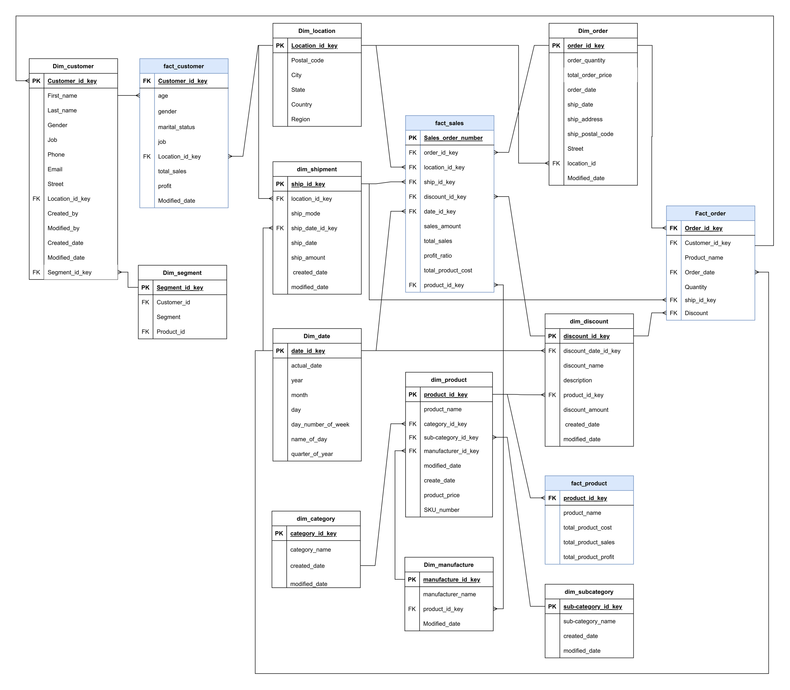
Data relationship model

Slide 12
Business Data Analysis
Group 10
3
DATA ANALYSIS AND RESULTS

Slide 13

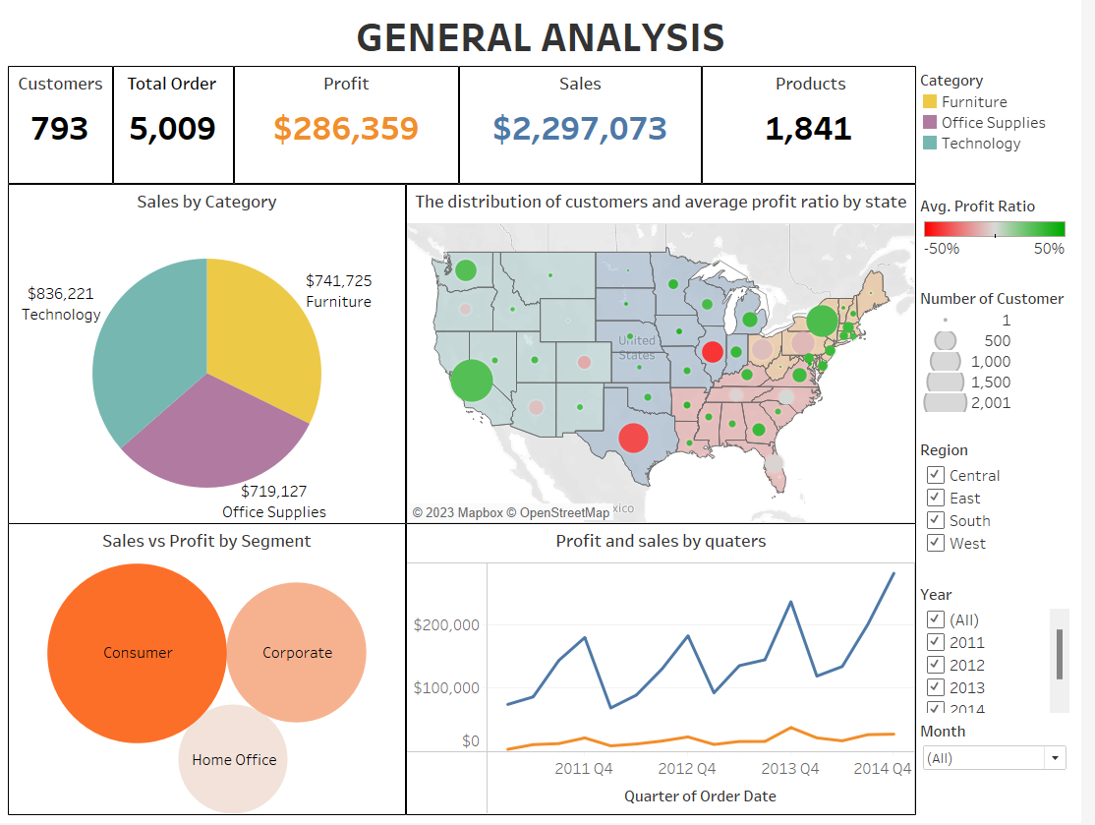
BUSINESS OVERVIEW ANALYSIS
Some important metrics
how many customers, how many orders, how many sold, how many products, profit.
Chart and Graph
Statistics of sales & profit and sales & profit by category, by segment, by quarters of the year.
Filter
by years, by months, by region

Slide 14
BUSINESS OVERVIEW ANALYSIS
Evaluate
Development Suggestion
Giving an overview of core business indicators, helping management easily understand the general business situation.
Develop a combination of comparing actual business metrics and business KPIs

Slide 15
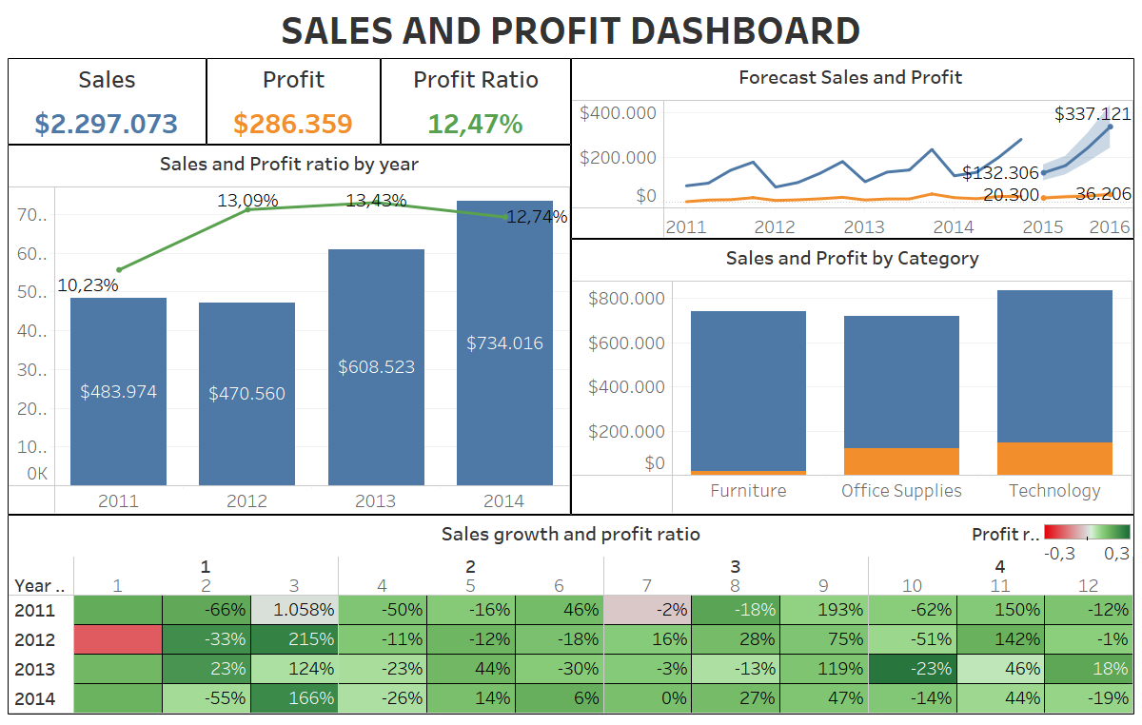
SALES & PROFIT ANALYSIS
Key metrics
Profit Ratio, Sales MoM (%), Profit MoM (%), Sales YoY (%), Profit YoY (%)
Identification
Sales are blue; Profit is Orange and Profit Ratio is shown in green
Data visualization
The mixed chart illustrates the changes in total sales and profit ratio over 4 years
The line chart visualizes the fluctuations in sales and profit in detail
The bar chart shows the sales and profits of the product category
A table shows the growth/ decrease of sales and profit margin month over month for all four years

Slide 16
SALES & PROFIT ANALYSIS
Evaluation
Development Suggestion
Sales tended to grow strongly after 2012 while the profit ratio decreased slightly, indicating that the company's strategy to boost sales is appropriate and correct. However, the company needs to pay more attention to the strategy for profit
The company's strategy should focus on both sales and profit growth. It may not be worth focusing any efforts on customers who generate low sales and low profits. Thus, retarget customers as well as potential customers that provide high sales - high profit and low sales - high profit
Geography: Proposing business expansion in high-revenue areas and implementing campaigns to entice customers in low-revenue areas.
Build buying habits for customers in special periods (March, September, November) to increase sales, then make price adjustments in the following year to get higher profits
The company can test the strategy of creating many promotions in the middle of the year (June, 7) to increase the company's sales
Adjust the selling price of the product category with high sales but low profits (here is the Furniture segment) to observe customers needs and buying behavior

Slide 17
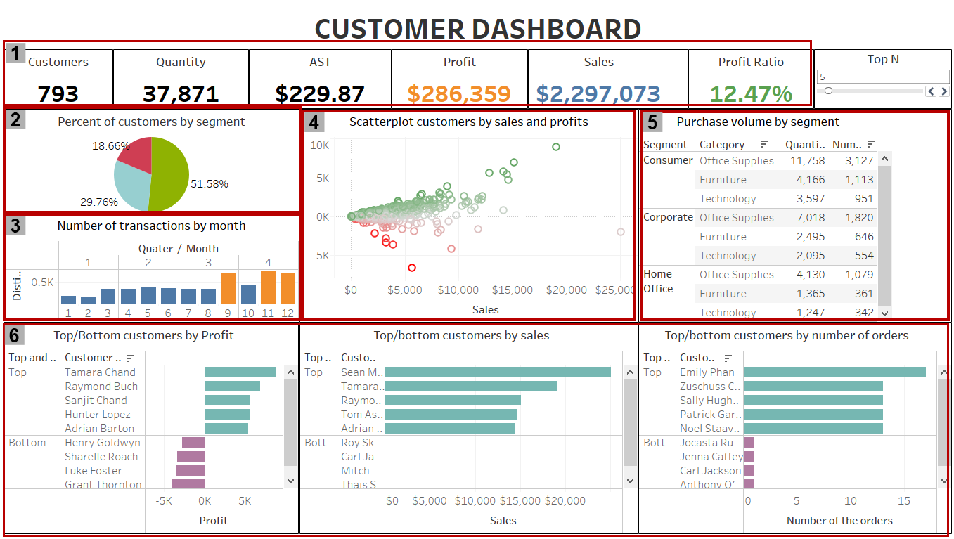
CUSTOMER ANALYSIS
Main section
1. General metrics
Customer, Quantity, AST, Sales, Profit, Profit Ratio
2. Overall proportions of our customer segments
3. Number of transactions by months
4. Scatterplot customers by sales and profit
5. Product category information data table
6. Top/ Bottom customers by profit/ sales/ orders
Data visualization of Customer Analysis

Slide 18

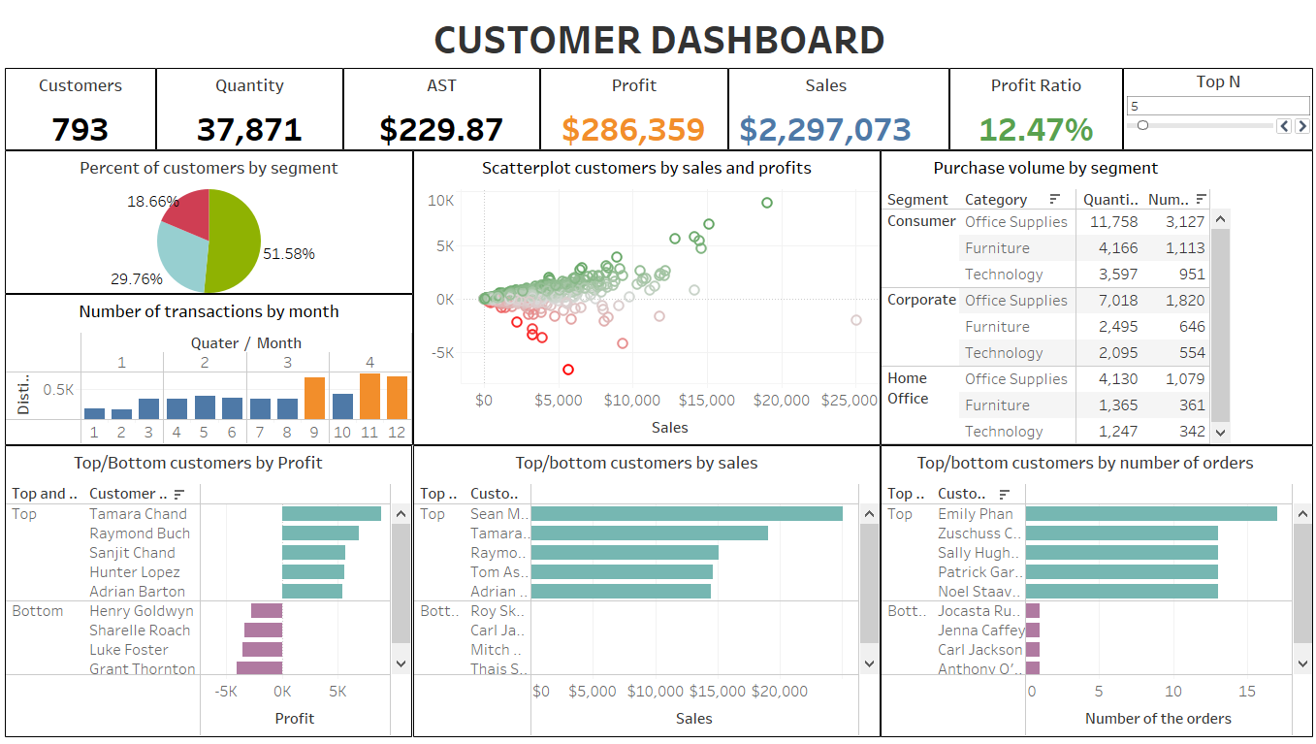
CUSTOMER ANALYSIS
Main output
segments
More than half of our current customers (51.58%) are categorized as "Consumer"
transactions per month
We witnessed a double increase in the number of transactions in the last quarter (especially September, November and December).
purchase volume
Office Supplies is the best selling category; furniture and technology respectively follow.
top customers
In all three top lists, “Consumer” segment outnumbers the others.
Data visualization of Customer Analysis

Slide 19
CUSTOMER ANALYSIS
Evaluation
Dicussion
Data of customers is too limited to gain detailed insights.
There shall be a necessity for changes in the customer data collections process. It should be particular enough to define our actual target segment.
The ASTs are noticeably nearly equivalent. There are no prominent segments because all three segments have almost the same impact.
The company should concentrate on attracting more and more customers in all categories.
If there is a noticeable difference in ASTs, the company may take into account the fact that which segments should be our target segments.
During the last four months, we witnessed a double increase in the number of transactions.
Gathering other data to find out the reasons behind that: Why do our customers love to purchase during that time (discount, urgent need,...) or is this a common situation for all businesses?
Importing new products, especially office supplies, and offering a variety of goods should be considered and completed before the last quarter. This helps to retain customers, captivate new ones, prevent shortage.
Business gifts, exceptional discounts, special offers... should be given to the top customers in order to maintain good relationships with them.
“Consumer” segment outnumbers the others in the top lists.
Figuring out which other products that they may like to expand their regular purchase list

Slide 20
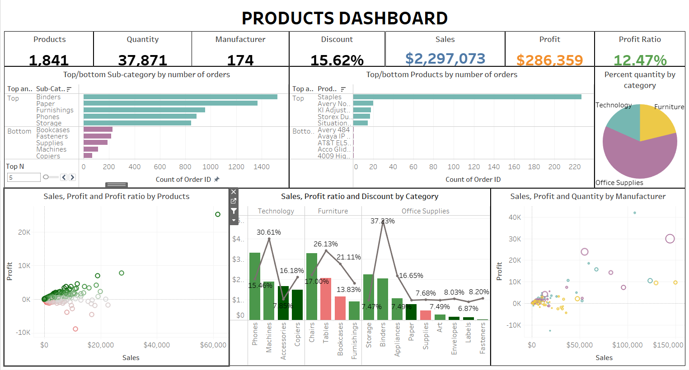
PRODUCT ANALYSIS
Products:
is the number of distinct counts of product names.
Quantity:
is the number of products that have been sold that year.
Manufacturer:
is the number of distinct counts of manufacturer.

Slide 21
PRODUCT ANALYSIS
Evaluate
Development Suggestion
Furniture category is the one that needs price adjustment the most due to its negative profit sub-category.
The other categories seem okay at first but there is something to do when we dive into the details. Most of the cases, the manufacturers do not work effectively. Besides, the average discount is too high. Perhaps, it’s just the temporary solution for long-term inventory.
Priority should be given to resource reallocation (both changing manufacturer and changing product in the same manufacturer) instead of removing items because the variety of goods is necessary. Keeping diversity of products is how the company keeps its position in the market.

Slide 22
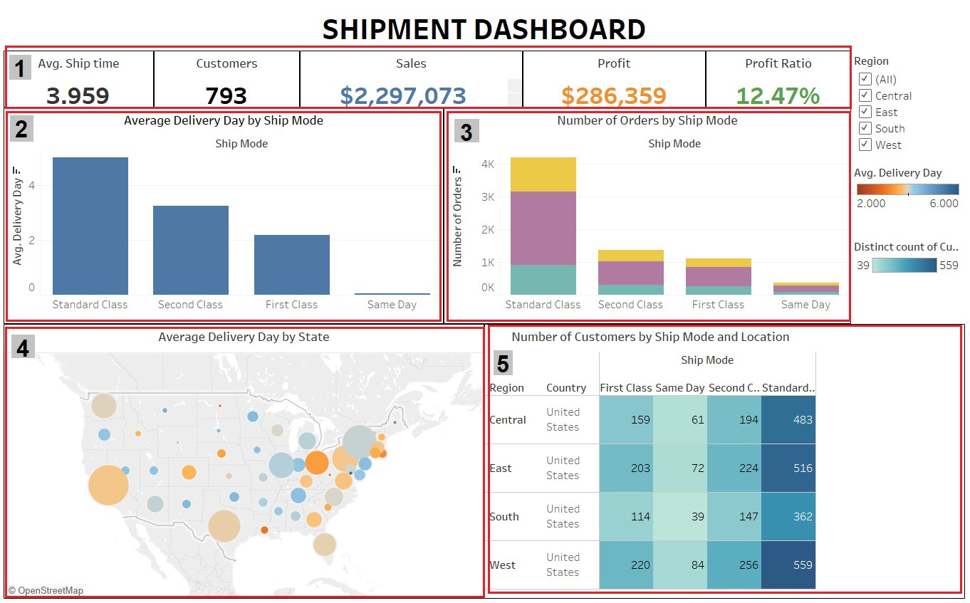
SHIPMENT ANALYSIS
Avg. Ship time:
Description: average delivery day
Formula: AVG([Delivery Day])
Ship mode
The most used ship mode is Standard class
Same day is the least used
Numbers of Customer by ship mode and Location
concentrated in the west region, the number of orders is gradually decreasing in the south region.

Slide 23
SHIPMENT ANALYSIS
Evaluate
Development Suggestion
In general, the average delivery time is 3,959 days per order.
The most used ship mode is Standard class (average delivery time is 5,007 days/order), while Same day is the least used (average delivery time is 0.044 days/order).
Orders are spread evenly in each area but are more concentrated in the west region, the number of orders is gradually decreasing in the south area.
“Standard class” of the West region has the highest number of customers but has the longest delivery time.
“Standard class” ship mode of the South region has the fastest delivery but the number of orders is the smallest.
Need to adjust the delivery time of “Standard class”, especially the west area
Implement marketing plans, attract customers in the south region
Looking for solutions to help customers approach and use ship mode “Same day”

Slide 24
Business Data Analysis
Group 10
4
CONCLUSION

Slide 25

CONCLUSIONS
ADVANTAGES
LIMITATIONS
Members actively contribute in meetings, participate fully and complete the project completely.
Apply analytical methods and learn knowledge to the project effectively.
Know how to use Tableau proficiently to analyze data.
Have basic knowledge of data analysis in business.
The number of chart types is limited, there is not a variety of charts in the report.
The data is small and relatively clean, not including all the actual operations of a business enterprise.
Not having much experience in designing and using functions, so they have not given new and important insights.
Tableau's algorithms and advanced functions have not been applied to data analysis.
FUTURE WORKS
Combine multiple data sources, including more information close to reality.
Use a variety of additional tools and integrate a variety of charts to most effectively represent data, providing a variety of insights.
Learn about algorithms, advanced functions, to build a seamless, vivid story that attracts viewers.
Real-time data analysis.

Slide 26

Group 10
Business Data Analysis
THANK YOU

